Slide 1
A Minsky-Schumpeter Approach to Reconstituting Financial Institutions for the Capital Development of the Economy
L. RANDALL WRAY
University of Missouri-Kansas City, UMKC
WRAYR@UMKC.EDU
WWW.LEVY.ORG
http://neweconomicperspectives.blogspot.com/

Slide 2
Keynes-Minsky-Schumpeter
Keynes-Minsky: 3 outstanding faults
  Unemployment, Inequality, Instability
Minsky-Schumpeter: Innovation and finance
  Schumpeter: banks finance innovation, creative destruction
  Minsky: financial innovations
Integration: Evolution and Transformation
  Financial instability hypothesis
  Stages or Epochs: Money manager capitalism

Slide 3
Keynes-Minsky: Instability
Theory of Effective Demand
  No tendency to full emp
Investment theory of growth and the cycle
  Steady growth unlikely
Financial theory of investment
  Stability is destabilizing
Role for Big Government and Big Bank
  Constrain instability

Slide 4
Minsky-Schumpeter: Innovation and Economic Development
Banker as Ephor
  Established firm uses retained profit
  Innovator requires finance
Innovation drives growth
  Growth within circular flow slow and steady
  Innovation→transformative growth: Econ Development
Banks innovate, too
  Profit-seeking; circumvent constraints; stretch liquidity
But financial innovation need not be directed to economic development

Slide 5
Reconstituting the Financial System
Minsky Project: Reconstituting Finance to Promote Capital Development of the Economy
Requires Proper Framework
  1. a capitalist economy is a financial system;
  2. neoclassical economics is not useful because it denies that the financial system matters;
  3. the financial structure has become much more fragile;
  4. this fragility makes it likely that stagnation or even a deep depression is possible;
  5.a stagnant capitalist economy will not promote capital development;
  6.however, this can be avoided by apt reform of the financial structure in conjunction with apt use of fiscal powers of the government.

Slide 6
Reform requires understanding:
What do banks do?
Like all econ units, take positions in assets by issuing liabilities
  Make payments for customers
  Anyone can create money
Banks are highly leveraged (93-95%), must continually refinance positions
  Liquidity and insolvency; govt backstop
  If not, make position by selling out position; debt deflation
Types: commercial banking, investment banking, universal banking, public holding company
  Skeptical banker; profits come over time; success of lender requires success of borrower
  CB: how do I get repaid; IB: how can I sell this IOU

Slide 7
A Minsky Moment or a Minsky Half-Century?
Stages Approach 1980s-90s
  Commercial capitalism
  Finance capitalism
  Paternalistic (Managerial-Welfare State) capitalism
  Money Manager capitalism (predator state, financialization, ownership society, neoliberalism, neoconservativism, shadow banking)
    Stability bred instability
    Accumulation of financial assets/liabilities
    Globalization
    Securitization
    Self-supervision
Notes:
7

Slide 8
Boom and Bust
1980s Thrift & Bank Crises
  Thrifts and Commercial real estate
  Banks and LDC debt
1980s Leverage Buy-outs
  Michael Milken and Junk Bonds
1990s New Economy and Nasdaq
  “Irrational Exuberance”
2000s Residential Real Estate
  Subprimes; foreclosures
2000s Commodity Markets
  Quadrupled oil prices; food riots; starvation
  Each crisis worse than the previous
Notes:
8

Slide 9
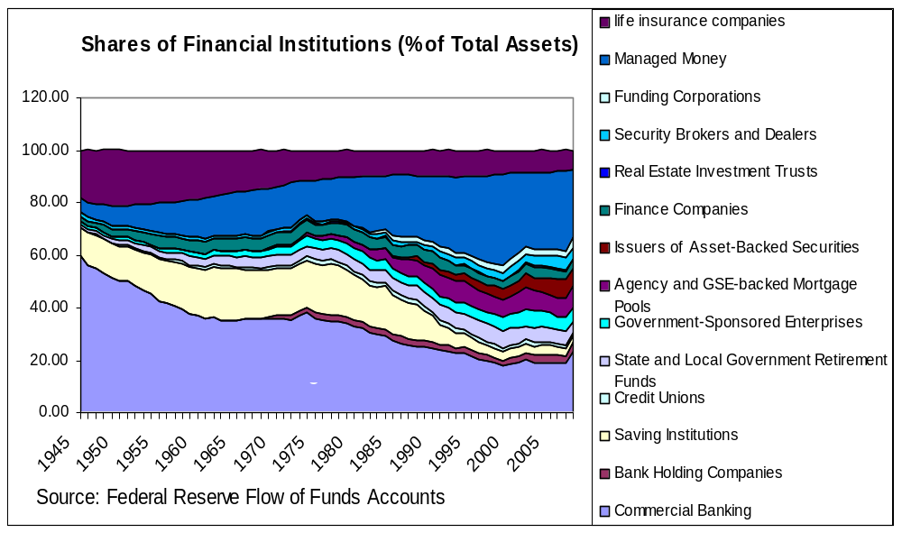
US: Decreasing Weight of the Banking Sector
Notes:
9

Slide 11
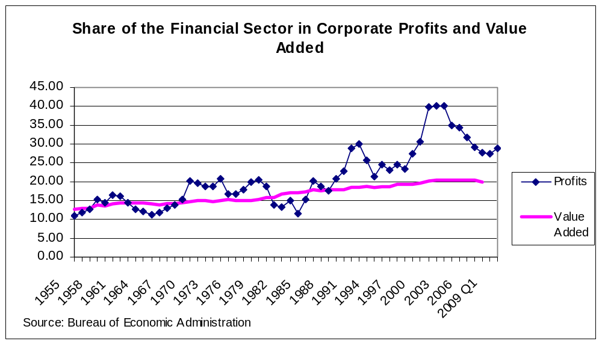
Financialization of the US Economy
Notes:
11

Slide 12
GFC: What went wrong?
Widespread “failures” in regulation and supervision
  Treasury, Fed, esp NYFed (Greenspan, Geithner, Rubin, Summers, Bernanke, Dodd, Gramm)
Dramatic failures of corporate governance and risk management
  Traders like Hank Paulson and Rubin rise to the top
  Fannie’s Franklin Raines max’s CEO salary
Excessive borrowing, risky investments, lack of transparency
Systemic breakdown in accountability and ethics
  Goldman’s teams

Slide 13
Next time: Let the Market Work
$29 Trillion to restore money mngr capitalism
Radical euthansia: all major banks will fail
All managed funds will fail: pensions, sovereign wealth funds, mutuals, insurers, hedge funds
  That is a good thing!
  Minsky’s “simplification” of the financial system
Will emerge with less private debt, more govt debt→robust financial system
  Constrained with new laws, supervision
  Return to underwriting, hold to maturity
Financialization replaced with new New Deal to resolve 3 faults

Slide 14
What Should Financial System Do?: Key Elements to Promote Capital Development
1. safe and sound payments system;
2. short term loans to households and firms, and, possibly, to state and local government;
3. safe and sound housing finance system;
4. a range of financial services including insurance, brokerage, and retirement savings services; and
5. long term funding of positions in expensive capital assets.
NB: there is no reason why these should be consolidated, nor why all should be privately supplied

Slide 15
Conclusions for Reform: Gov’t Role
Reducing concentration plus retaining risk can reorient banks back to relationship banking
Promote Public/Private Partnership for capital development
Role for gov’t to play in re-regulating and re-supervising
  There are no magic formulas (capital ratios, living wills, skin in the game)
Role for gov’t in direct provision of financial services
  Payments system
  Direct lending to serve public purpose
  Guarantees for public-private partnerships

